Slide 1

SENTIMENT ANALYSIS OF YELP REVIEWS
Methods of Data Science – Final Project
20th April 2023
By-
Shreyasi Biswas
Deepanshu Malhotra
Shruti Ravichandran

Slide 2
AGENDA
Introduction & Background
Past studies & their limitations
Project Objectives
Dataset
Exploratory Data Analysis
Data Transformation & Feature Creation
Multiclass classification results
Model Improvement Plan

Slide 3

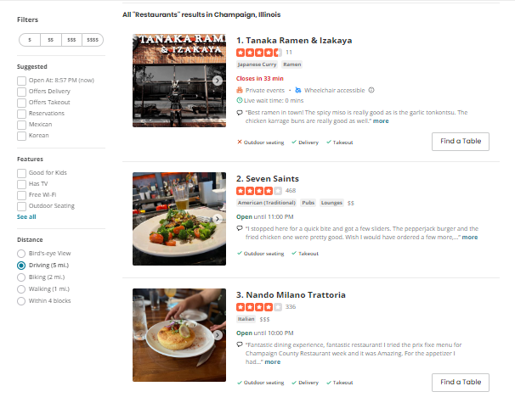
INTRODUCTION & BACKGROUND
What is
Sentiment Analysis ?
Sentiment analysis is a way to understand emotions and opinions in text.
It uses algorithms and machine learning to analyze text and determine positive, negative, or neutral sentiment.
It helps companies monitor social media, analyze feedback, and improve products/services.

Slide 4
PAST STUDIES & THEIR LIMITATIONS
 | Xiong et al. (2018) | Ghose and Ipeirotis (2011) | Rao, Jinfeng, et al (2015)
STUDY | Used Deep-learning model to classify Yelp reviews as positive or negative | Focused on the impact of online reviews on the sales of local businesses | Extracts important features of restaurants such as quality of food, ambiance, service, etc using NLP
LIMITATION | Does not look at reviews that could be more ambiguous or neutral | Uses a set of pre-defined features to represent reviews the reliability of which is unknown | Does not provide an overall score for the sentiment expressed in the review
HOW WE ADDRESS IT | Classifies reviews into 5 categories – Great, Good, Neutral, Bad, Poor | Extracts custom features using NLP techniques from the reviews | First extracts features from reviews and then uses them to generate an overall sentiment for the review

Slide 5

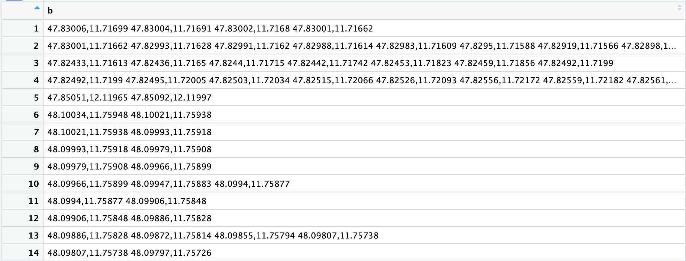
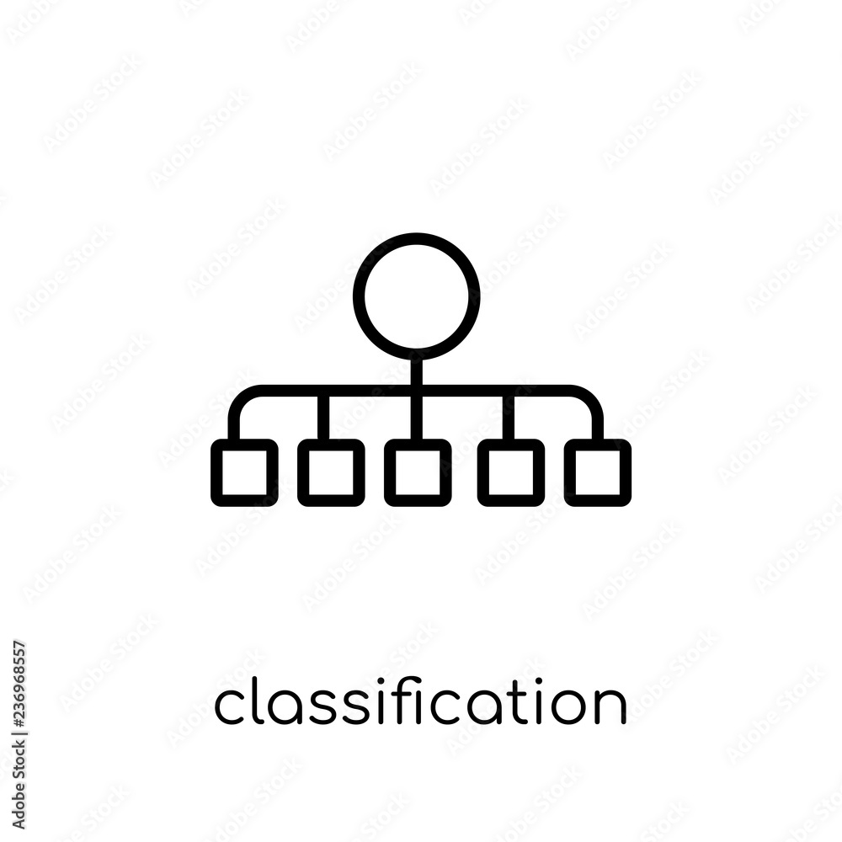

PROJECT OBJECTIVES
Text Preprocessing
Multiclass Classification of Reviews
Extracting textual features into numeric data to make it understandable for ML models
Processed reviews are used to train different classification models to predict whether the sentiment from a review is Great, Good, Neutral, Bad, Poor
10% Great
20% Good
Tokenize
Remove Stopwords
Lemmatize
Vectorize
30% Neutral
25% Bad
Vector representation of reviews
15% Poor
Textual Reviews
NLP processing
100% - all reviews
Sentiment classified reviews
Notes:
NLP Icon - <a href="https://www.flaticon.com/free-icons/nlp" title="nlp icons">Nlp icons created by Freepik - Flaticon</a>

Slide 6
DATASET
Overview
10K Reviews
~6.3K Users
~4.1K Businesses
5 Stars
business_id | date | review_id | stars | text | type | user_id | cool | useful | funny
9yKzy9PApeiPPOUJEtnvkg | 1/26/2011 | fWKvX83p0-ka4JS3dc6E5A | 5 | My wife took me here on my birthday for breakfast and it was excellent. The weather was perfect which made sitting outside overlooking their grounds an absolute pleasure. It looked like the place fills up pretty quickly so the earlier you get here the better. | review | rLtl8ZkDX5vH5nAx9C3q5Q | 2 | 5 | 0
ZRJwVLyzEJq1VAihDhYiow | 7/27/2011 | IjZ33sJrzXqU-0X6U8NwyA | 5 | My friend and I arrived at about 5:50 PM this past Sunday. It was pretty crowded, more than I thought for a Sunday evening and thought we would have to wait forever to get a seat but they said we'll be seated when the girl comes back from seating someone else. We were seated at 5:52 and the waiter came and got our drink orders. We shared the baked spaghetti calzone and the small "Here's The Beef" pizza so we can both try them. The calzone was huge and we got the smallest one (personal) and got the small 11" pizza. Both were awesome! | review | 0a2KyEL0d3Yb1V6aivbIuQ | 0 | 0 | 0
6oRAC4uyJCsJl1X0WZpVSA | 6/14/2012 | IESLBzqUCLdSzSqm0eCSxQ | 4 | Love the gyro plate. Rice is so good and I also dig their candy selection :) | review | 0hT2KtfLiobPvh6cDC8JQg | 0 | 1 | 0
6ozycU1RpktNG2-1BroVtw | 1/5/2012 | 1uJFq2r5QfJG_6ExMRCaGw | 3 | General Manager Scott Petello is a good egg!!! Not to go into detail, but let me assure you if you have any issues (albeit rare) speak with Scott and treat the guy with some respect as you state your case and I'd be surprised if you don't walk out totally satisfied as I just did. Like I always say..... "Mistakes are inevitable, it's how we recover from them that is important"!!! | review | vYmM4KTsC8ZfQBg-j5MWkw | 0 | 0 | 0
Notes:
We are using the YELP dataset consisting of around 10000 reviews, 6.3K users, 4.1K Business and star ratings out of 5 for each of the reviews. This dataset was sourced from Kaggle.
This is a screenshot of what the dataset looks like. It’s a simple dataset - the columns of importance here are the Star ratings and the reviews themselves.
The features that are used to predict the sentiment will be extracted from the text column and the stars column is our target variable that our model is predicting
The dataset was already pretty clean, so I just want to quickly mentioned the steps we performed before moving on to the EDAs:
Checked for nulls, duplicates, and outliers and removed them
Some columns like the “type” column were Irrelevant, so we removed it from our analysis
Finally, we standardized the datatype of all the columns

Slide 7
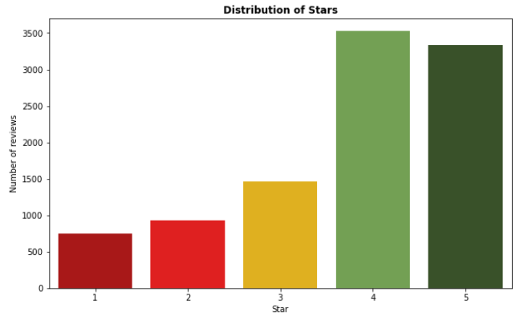
EXPLORATORY DATA ANALYSES
The dataset appears to be unbalanced as the number of reviews with a rating of 4 and 5 stars is much higher than the number of reviews with a rating of 1, 2, or 3 stars
This can lead to issues when building a sentiment analysis model as it may become biased towards predicting positive sentiments due to the higher number of positive reviews
To mitigate this, we undersampled all classes to match Class 1
Distribution of Stars
Notes:
Our main objective while going in for the EDA process was to assess the feasibility of using this dataset for sentiment analysis. That is, we wanted to see if the labels we have make sense juxtaposed to the star rating since this would be the primary source of learning for our classification model
The chart you see here shows the distribution of #reviews by the star ratings -

Slide 8
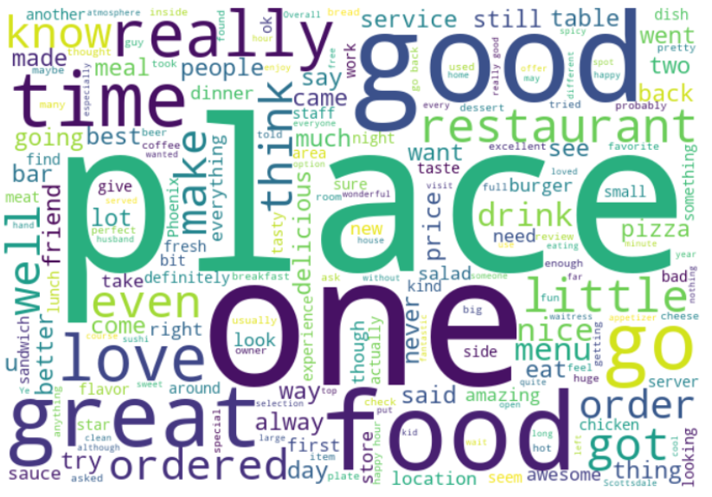
EXPLORATORY DATA ANALYSES
The words “restaurant”, “food”, “drink” stand out, indicating that most of the reviews are about restaurants or other places that serve food
The adjectives “good” and “great” stand out the most. This is expected given that our dataset has more 4 and 5 star rated reviews than 1, 2 and 3 star reviews
Notes:
The next step in our analysis was to see what kind of words are used most in the reviews. This is mainly to check if we have enough data for reviews about different kinds of things - restaurants, parks, hotels, activities, etc.
To do this, we first performed all the NLP preprocessing steps at the end of which the text contained of important words from the entire review.
Then, we plotted a word cloud across all the reviews - The size of the word here proportional to the frequency of the word across all the reviews.
The words “restaurant”, “food”, “drink” stand out, indicating that most of the reviews are about restaurants or other places that serve food. so this tells us that perhaps one thing to be aware of with our analysis would be that the model may not be as effective with reviews about other types of things

Slide 9
EXPLORATORY DATA ANALYSES
Top 10 most common words in each class after NLP techniques were applied
Poor
Bad
Neutral
Good
Great
Notes:
To see if the star rating assigned to the reviews make sense, we broke down the reviews by their assigned star rating and looked at the top 10 most frequent words
So if you pay attention to some of the highlighted words here, you can observe that in the reviews rated 1, which is the POOR class, “bad” is third frequent.
When you go to star rating 2, which is the “bad” class, a positive adjective pops up - “Nice”
In the next class - rating 3 - there are more positive adjectives moving towards the top of the chart - “great” and “nice” and the negative adjectives like “bad” ad “small” have slid downwards
Rating 4 - Don’t see any negative adjectives in the top 10. There are some new positive adjectives like “delicions”, “happy”
Rating 5 - great has moved to the top of the chart
This shows that the text in the reviews are congruent to the star rating

Slide 10
DATA TRANSFORMATION & FEATURE CREATION
NLP Preprocessing
Additional Feature Creation
Tokenization:
Process of breaking a text into individual units – sentences or words called as tokens
Features created after lemmatization:
Review length in terms of number of relevant words
Top 5 most frequent adjectives for each class
Polarity: If a statement is positive (1) or negative (-1)
Subjectivity: If a statement is a personal opinion (0) or factual information (1)
Stopword Removal:
Removing commonly used words, such as "the" and "is", from a text to focus on more relevant words
Lemmatization:
Reducing words to their base or dictionary form
“I am swimming in the ocean”
“I be swim in the ocean
Vectorization:
Converting text into numerical representations to enable mathematical analysis

Slide 11
MULTICLASS CLASSIFICATION INITIAL RESULTS
All models perform better for classes Poor, Good and Great as compared to Bad and Neutral
 | Metric | Poor | Bad | Neutral | Good | Great
Random Forest | Precision | 64% | 35% | 29% | 40% | 53%
 | Recall | 16% | 3% | 5% | 64% | 59%
 | F1-Score | 26% | 5% | 9% | 49% | 56%
SVM | Precision | 61% | 48% | 42% | 43% | 56%
 | Recall | 20% | 6% | 10% | 66% | 64%
 | F1-Score | 30% | 10% | 16% | 52% | 59%
Naïve Bayes | Precision | 60% | 41% | 31% | 43% | 61%
 | Recall | 30% | 10% | 7% | 73% | 55%
 | F1-Score | 40% | 16% | 12% | 54% | 58%
Notes:
If you observe the shading on these results, the darker shades occur around classes 1, 4 and 5 which tells us that all the models perform better on Class 1, 4 & 5 as compared to 2 & 3.
Also, all the models give a better precision than recall for classes 1, 2 and 3 indicating that the model is making more number of correct predictions, at the cost of missing some reviews that should ideally have been put in those classes
All the models give a better recall for classes 4 & 5 indicating that the model is able to capture more labels for these classes at the cost of precision
A better model would balance all these aspects
Overall, Naive Bayes looks like the best model as its scores are the most balanced across the board

Slide 12
MULTICLASS CLASSIFICATION INITIAL RESULTS
Better precision compared to recall observed in classes Poor, Bad and Neutral
 | Metric | Poor | Bad | Neutral | Good | Great
Random Forest | Precision | 64% | 35% | 29% | 40% | 53%
 | Recall | 16% | 3% | 5% | 64% | 59%
 | F1-Score | 26% | 5% | 9% | 49% | 56%
SVM | Precision | 61% | 48% | 42% | 43% | 56%
 | Recall | 20% | 6% | 10% | 66% | 64%
 | F1-Score | 30% | 10% | 16% | 52% | 59%
Naïve Bayes | Precision | 60% | 41% | 31% | 43% | 61%
 | Recall | 30% | 10% | 7% | 73% | 55%
 | F1-Score | 40% | 16% | 12% | 54% | 58%
Notes:
If you observe the shading on these results, the darker shades occur around classes 1, 4 and 5 which tells us that all the models perform better on Class 1, 4 & 5 as compared to 2 & 3.
Also, all the models give a better precision than recall for classes 1, 2 and 3 indicating that the model is making more number of correct predictions, at the cost of missing some reviews that should ideally have been put in those classes
All the models give a better recall for classes 4 & 5 indicating that the model is able to capture more labels for these classes at the cost of precision
A better model would balance all these aspects
Overall, Naive Bayes looks like the best model as its scores are the most balanced across the board

Slide 13
MULTICLASS CLASSIFICATION INITIAL RESULTS
Better recall observed in class Good
Balanced results in Class Great
 | Metric | Poor | Bad | Neutral | Good | Great
Random Forest | Precision | 64% | 35% | 29% | 40% | 53%
 | Recall | 16% | 3% | 5% | 64% | 59%
 | F1-Score | 26% | 5% | 9% | 49% | 56%
SVM | Precision | 61% | 48% | 42% | 43% | 56%
 | Recall | 20% | 6% | 10% | 66% | 64%
 | F1-Score | 30% | 10% | 16% | 52% | 59%
Naïve Bayes | Precision | 60% | 41% | 31% | 43% | 61%
 | Recall | 30% | 10% | 7% | 73% | 55%
 | F1-Score | 40% | 16% | 12% | 54% | 58%
Notes:
If you observe the shading on these results, the darker shades occur around classes 1, 4 and 5 which tells us that all the models perform better on Class 1, 4 & 5 as compared to 2 & 3.
Also, all the models give a better precision than recall for classes 1, 2 and 3 indicating that the model is making more number of correct predictions, at the cost of missing some reviews that should ideally have been put in those classes
All the models give a better recall for classes 4 & 5 indicating that the model is able to capture more labels for these classes at the cost of precision
A better model would balance all these aspects
Overall, Naive Bayes looks like the best model as its scores are the most balanced across the board

Slide 14
MULTICLASS CLASSIFICATION INITIAL RESULTS
All models perform better for classes Poor, Good and Great as compared to Bad and Neutral
 | Metric | Poor | Bad | Neutral | Good | Great
Random Forest | Precision | 64% | 35% | 29% | 40% | 53%
 | Recall | 16% | 3% | 5% | 64% | 59%
 | F1-Score | 26% | 5% | 9% | 49% | 56%
SVM | Precision | 61% | 48% | 42% | 43% | 56%
 | Recall | 20% | 6% | 10% | 66% | 64%
 | F1-Score | 30% | 10% | 16% | 52% | 59%
Naïve Bayes | Precision | 60% | 41% | 31% | 43% | 61%
 | Recall | 30% | 10% | 7% | 73% | 55%
 | F1-Score | 40% | 16% | 12% | 54% | 58%
Notes:
If you observe the shading on these results, the darker shades occur around classes 1, 4 and 5 which tells us that all the models perform better on Class 1, 4 & 5 as compared to 2 & 3.
Also, all the models give a better precision than recall for classes 1, 2 and 3 indicating that the model is making more number of correct predictions, at the cost of missing some reviews that should ideally have been put in those classes
All the models give a better recall for classes 4 & 5 indicating that the model is able to capture more labels for these classes at the cost of precision
A better model would balance all these aspects
Overall, Naive Bayes looks like the best model as its scores are the most balanced across the board

Slide 15
MODEL IMPROVEMENT PLAN & LIMITATIONS
Improvements planned for current project scope
Use vectorization techniques that take model semantics into consideration such as Word2Vec, FastText, etc
Handling data imbalance –
Using classic Oversampling or SMOTE
Setting class weight parameter for the models
Hyperparameter Tuning using grid search and cross validation
Limitations
Reviews could have text like “The food was amazing but the service was horrible, which is why I give a low rating” – If the reviews have equal number of sentences conveying positive and negative points, then the model could get confused while learning
Sarcasm and irony would also confuse the learning process
Notes:
Checked for the following (voice over) –
Nulls
Duplicates
Outliers
Irrelevant columns
Datatype change

Slide 16

THANK YOU!

